Slide 1
Hard Systems Case Studies
Presentor: Ismail Coşgun

Slide 2
DrillCorp
An offshore contractor for oil and gas drilling.
One of the best in the drilling business.
However, they were challenged to thrive in the competitive world market.
Aim: To become more formal and professional in how it managed itself.
Hired a system consultant to lead the development.

Slide 3
Step 1: Groundwork
Consultant made an initial study of DrillCorp:
Entailed structured interviews with directors and shore-based managers
With Offshore install managers(OIM), rig masters and other crew members on a sample drilling installation on North Sea.
Essential activies and the processes of the business were studied.(onshore and offshore)
Existing management methods and assumptions were noted.
World-views of the various groups within the company examined.

Slide 4
Step 2: Awareness and Understanding
There is a shared world-view: The continual need to strive for improved performance and competitiveness.
Number of projects were a mess: Inability to answer customer queries, vital equipments on shore running out on critical moments.
Spray Diagram of Offshore Drilling can be seen in Figure 1.

Slide 5
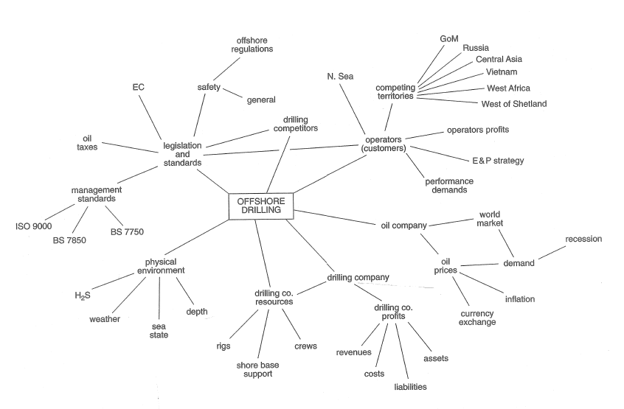
Figure 1: Spray Diagram

Slide 6
2. Awareness and Understanding
World-view had ups and downs.
Up: Everyone agreed for a change.
Down: New approach required changes in company beliefs.
Experience is the best teacher. Formal training is necessary evil.
Time pressures is not a good reason for managers to manager their time.
Consultant: Although the change was necessary formal problem solving would not be adequate.
Too many variables were changing in the enviroment.
New arrangements would not only have to be functionally adequate but also have to deal effectively with issues such as perception of time, value of time etc.

Slide 7
2. Awareness and Understanding
Consultant decided to adress «Company Management System»
A new potential system: Drillcorp company management system to provide effective application of company resources.
Operating costs are reduced while competitiveness and profit remained.
Company meets performance demands of customers.
At first iteration, company management system was seperated as in Figure 2.
Than a system map was created as in Figure 3.

Slide 8
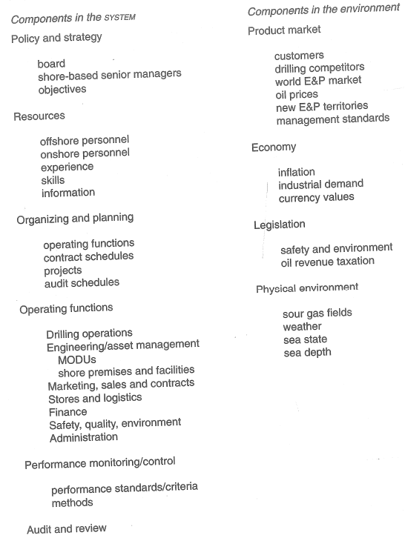
Figure 2: Seperation of system

Slide 9
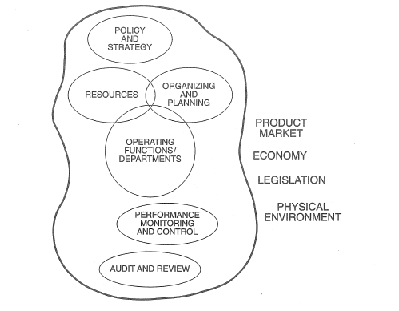
Figure 3: System map of management

Slide 10
2. Awareness and Understanding
Effective management was influenced by a number of factors.
Finances
Skill resources and competent personnel
Time made available
Information
Organization and Planning
Standards and Performance Criteria
Those influences are shown in Figure 4

Slide 11
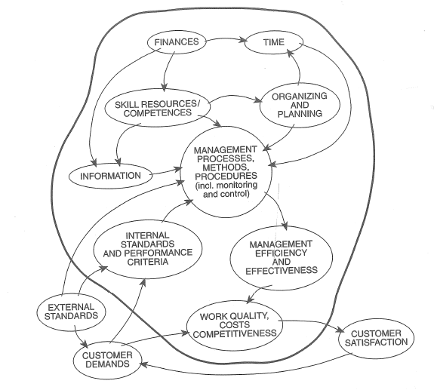
Figure 4: Diagram Of Influences

Slide 12
2. Awareness and Understanding
After the analysis the consultant took the view:
Dynamic variables of costs and competitiveness were linked causally to management efficiency. (shown in Figure 5)
Absence of control loops shows the necessity of ensurement of management efficiency.

Slide 13
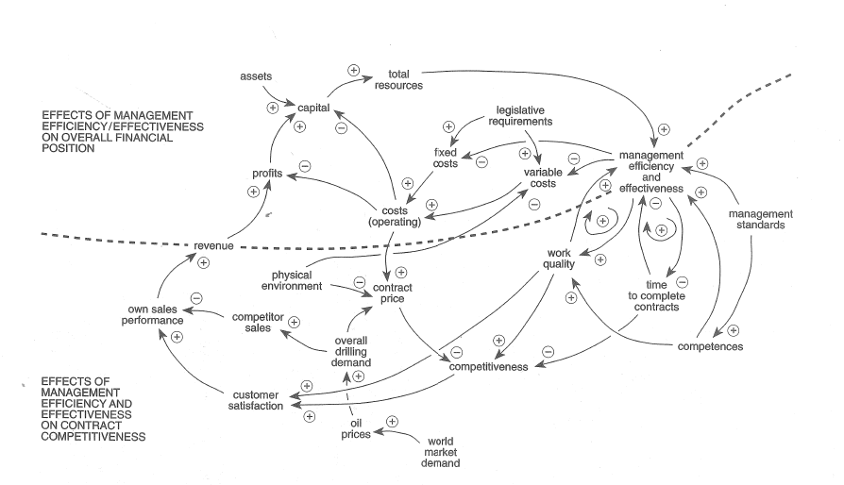
Figure 5: Dynamic Variables operating relatively to management system

Slide 14
Step 3. Objectives and Constraints
Ultimate objectives: Increase the sales and profit.
So: Improve contract competitiveness and customer satisfaction through;
Reduced Operating Costs
Competitive Tender Prices
Improved Work Quality
Reduced Time to Complete Contracts
This hierarcy is shown in Figure 6.

Slide 15
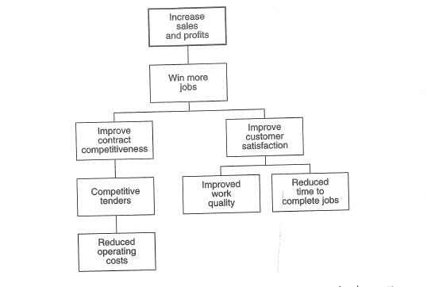
Figure 6: Objective Hierarcy

Slide 16
Step 4. Strategies to Meet Objectives
Consultant identified 3 possible strategies.
A: Develop the management system and obtain certification to relevant international standards
B: Develop the management system using relevant standards but don’t get certified.
C: Develop the management system using DrillCorp’s internal standards(Certification is the reserve option)

Slide 17
4. Strategies to Meet Objectives: Strategy A: ISO 9000 Certificate
DrillCorp will get accredited by a third party organization.
Company Management System will be examined.
Consultancy and Assistance will be provided.
Final Audit will be conducted.
The result of this steps will decide whether DrillCorp should be accredited or not.
ISO 9000 Certificate will indicate DrillCorp has a «quality» management system.

Slide 18
4. Strategies to Meet Objectives: Strategy B: Uncertified System to ISO 9000 and BS 7850
Drillcorp will develop its management system according to ISO 9000 and BS 7850:1992 Total Quality Management.
They will not get accredited.
Consultancy assistance might be required.

Slide 19
4. Strategies to Meet Objectives: Strategy C: Uncertified System from First Principles
DrillCorp will use its own internal standards.
Consultancy Assitance is almost certainly required.
If the market demands for a certification, DrillCorp can always apply for certification.

Slide 20
Step 5. Assesment Measures
In relation to defined objectives which strategy must be chosen?
Quantitative Measures:
Quantitative measures should include basic outcome measures of efficiency such as, contract tender prices in relation to development and maintenance cost.
Quantitative measures of effectiveness should include profit margins and quality assurance measures.(equipment reliability, drilling accuracy, damage and accident rates).

Slide 21
5. Assesment Measures
Qualitative Measures
Should include relative realism of the management system paradigms in three strategies.(How well the paradigms work in real world and actual systems?)
Important since some models are more complete in real world.
Should include whether the models are fit with customer world-view and DrillCorp world-view.

Slide 22
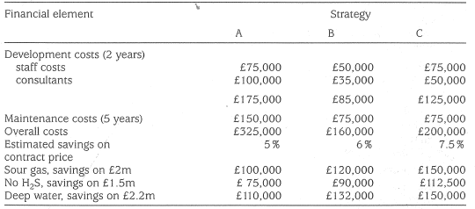
Step 6. Modelling
Using three typical contract specifiations a relatively simple financial model based on costs and savings was used to generate comparative data.( Figure 7)
Figure 7

Slide 23
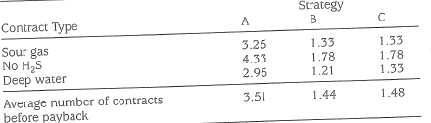
6. Modelling
Then by dividing the costs by the contract savings a payback data were obtained.( Figure 8)
Figure 8

Slide 24
6. Modelling
As can be seen, in Figure 8 all the strategies have a fairly quick return however, B and C are paying themselves in the second contract while A will take 4 contracts.

Slide 25
Step 7. Evaluation
Costs and Savings summary was discussed with DrillCorp client-set.
While at first glance, strategy A provides a weaker return.
However, greater savings on B and C was based on the assumption that certified systems represents a less complete model of a human activity system.
Actual quality assurance, is likely to be better with strategy C.
While this may seem odd ( ISO 9000 certificates quality management), these standards are based on a simple I process/O feedback model and they do not cover world-view’s or power relations in the organization.

Slide 26
7. Evaluation
Of course, DrillCorp recognized Strategy A will be helpful in winning contracts.
However, many operators within the organization questioned the real value of certificate. (Past experiences were not good)
DrillCorp was very independent and did not like the idea of third party evaluation.( Conflict with the world-view)
In Layman’s Terms: They had trust issues. (Would the consultant work for the best interests of DrillCorp or the mentioned third party?)

Slide 27
7. Evaluation
The client-set was asked to score the following factors from 1 to 10.
Estimated contract savings
Pay back period
Actual quality assurance provided
Realism and completeness of the model
Fit with customer world-views
Fit with company world-views.

Slide 28
Step 8. Making A Choice
Strategy A was unfavourable on both financial and qualitative grounds.
Strategy B was more favourable than Strategy C on financial grounds but less favourable on qualitative grounds.( Comparable)
The question «Why bother on a third party formula if we will not get the recognition for it?» helped their decision.
The results mentioned above can be seen in Figure 9 and 10.

Slide 29
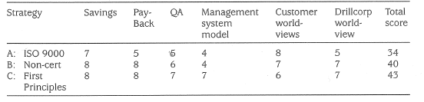
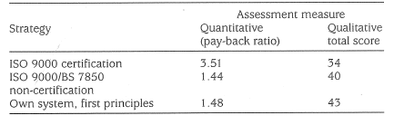
Figure 9: Client-Set scores
Figure 10: Overall Scores

Slide 30
8. Making A Choice
After the results, Strategy C was decided to implement since the resultant management system was «owned» by them and was more realistic and complete than the external standards.
Also, the option for applying for a standard( Strategy A) is always open if the company thinks a commercial advantage can be gained.

Slide 31
Step 9. Implementation
Once the strategy has been decided DrillCorp began the task of organizing, planning and resourcing its implementation.

Slide 32
Thank you for your attention! Any Questions?

